Slide 1
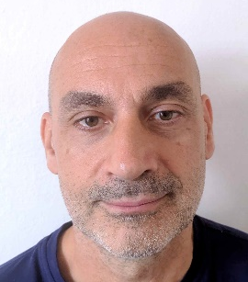
Jiri Votruba
Pulmonary endoscopy specialist
Head of Pulmonary diseases clinic department
Jiri is a lung specialist and an internist. He specializes in the treatment of respiratory diseases, diagnosis and treatment of coughs and cessation of smoking. He is a pulmonary endoscopy specialist preforming both diagnostic and therapeutic procedures, e.g. endoscopic volume reduction, bronchial thermoplasty, pleuroroscopy, stenting procedures and coiling. During his 27 years of practice he worked in many leading Czech hospitals and clinics. At present he is the head physician of the 1st Clinic of Tuberculosis and Respiratory Diseases of General University Hospital in Prague and 1st Medical Faculty of Charles University in Prague. The clinic was founded in 1932 and is the oldest facility of its kind in our country. He is a member of both Czech and international professional societies, such as the European Respiratory Society, World Association for Bronchology and Interventional Pulmonology or the Czech Association of Allergologists, and is actively involved in the Oxyprotect civic association that helps fight lung cancer. Every year, he also actively participates in international events and scientific conferences.

